Slide 1
JCM OSCE Questions
Caritas Medical Centre
3 June, 2015

Slide 2
Question 1
A 30-year-old man presented to the AED with acute onset of bilateral lower limb weakness. He also complained of recent weight loss of 10 lbs in 2 months. Physical examination found marked decreased in proximal muscle power, with decreased deep tendon reflexes. His vital signs: BP 110/54mmHg, P 110/min; An ECG was performed.

Slide 3
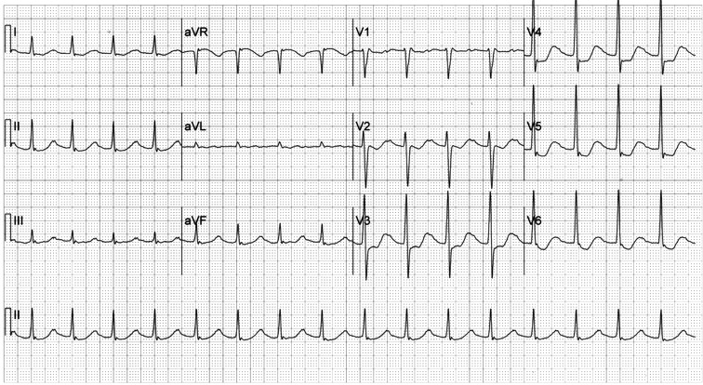

Slide 4
Question 1
1a. Describe the ECG finding.
1b. What is your diagnosis?
1c. Name 3 important steps in managing this patient
1d. Name 3 precipitating factors for this condition
1e. Suggest 1 prophylactic medication to prevent this condition from happening

Slide 5
1a. Describe the ECG findings
ECG shows
  sinus tachycardia at approximately 100 beats per minute,
  prolonged PR intervals (P waves partly hidden in the preceding repolarization complex)
  ST depressions V2-V6
  A prolonged QT-U interval
  (compatible with hypokalaemia)

Slide 6
1b. What is your diagnosis ?
Thyrotoxic periodic paralysis

Slide 7
1c. Name 3 important steps in managing this patient
  Cardiac monitor
  Blood tests (esp RFT, K level, TFT)
  Slow correction of hypokalemia, avoid rebound hyperkalemia
  Treat underlying thyrotoxicosis

Slide 8
1d. Name 3 precipitating factors for this condition
Ingestion of high carbohydrate loads
Physical exertion
Trauma
Cold exposure
Infection
Emotional stress

Slide 9
1e. Suggest 1 prophylactic medication to prevent this condition from happening
Propanolol

Slide 10
Question 2
A 45-year-old man chronic drinker was sent by ambulance to ED for confusion and vomiting. He was unable to take food for 3 days. Blood results as follows:

Slide 11
Blood results
WCC 11.6 x 10^9/L
Hb 15.7 g/dL
MCV 105.2 fL
Na 140 mmol/L
K 3.8 mmol/L
Cr 150 mmol/L
AST 414 u/L
ALT 198 u/L
Bilirubin 44mol/L

Slide 12
2a. Explain the likely cause of the abnormalities in patient’s blood tests
2b. Give 4 physical signs on examination of hands that are suggestive of chronic liver disease
2c. Give 3 features of acute delirium tremens
2d. Outline the ER management

Slide 13
2a. Explain the likely cause of the abnormalities in patient’s blood tests
Markedly raised MCV with normal Hb is consistent with chronic alcohol consumption
Raised AST, ALT (AST rise greater than ALT rise) and raised bilirubin is typical of alcoholic liver disease
Raised creatinine due to dehydration

Slide 14
2b. Give 4 physical signs on examination of hands that are suggestive of chronic liver disease
Liver flap
Clubbing
Duputren’s contracture
Palmar erythema

Slide 15
2c. Give 3 features of acute delirium tremens
Marked visual hallucinations
Confusion and disorientation
Autonomic hyperactivity (fast pulse, raised BP, fast RR)
Uncontrollable course tremor
Some may have seizures or fever (non-specific)

Slide 16
2c. Outline the ER management
Airway maintenance
Cardiac monitor (arrhythmia from acidosis and electrolyte disturbance)
Maintain hydration with IV saline, correct electrolyte abnormality
Give anti-emetics
Treatment of hypoglycemia
Parenteral thiamine to treat thiamine deficiency and avert Wernicke’s encephalopathy
Look of co-existing disease (eg. Chest infection, MI, sepsis, pancreatitis etc.)
Sedation with parenteral benzodiazepines
Admit to medical team

Slide 17
Question 3
A 35-year-old man, with good past health, attempted suicide by taking a pack of mothballs two days ago. He was sent by ambulance to AED with a complaint of increasing generalised weakness. On arrival, he had stable vital signs and was fully conscious. Urine sample was saved.

Slide 18
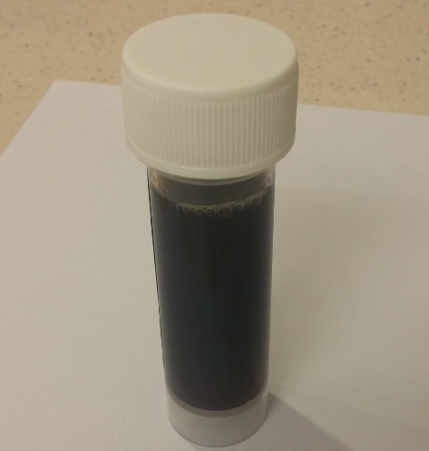
Urine sample

Slide 19
Question 3
3a. What do mothballs contain?
3b. What does the urine sample signify?
3c. Which kind of mothball had the patient taken?
3d. How do you distinguish different mothballs clinically?
3e. What are the potential complications of this patient?

Slide 20
3a. What do mothballs contain?
Naphthalene
Camphor
Paradichlorobenzene

Slide 21
3b. What does the urine sample signify?
Haemolytic anaemia

Slide 22
3c. Which kind of mothball had the patient taken?
Naphthalene mothballs

Slide 23
3d. How do you distinguish different mothballs clinically?
Paradichlorobenzene is a denser chemical, it is radioopaque on X ray and will sink if dropped into a glass of salted water. Naphalene is barely radioopaque and will float atop of a glass of salted water.
Signs and symptoms of camphor poisoning are seen soon after ingestion. Naphalene ingestion had delayed signs and symptoms.

Slide 24
3e. What are the potential complications of this patient ?
Haemolysis
Methemoglobinemia
GI irritation

Slide 25
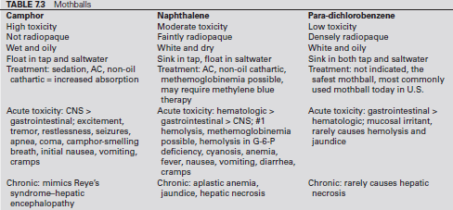

Slide 26
Question 4
An 18 –year- old boy presents to the ED one day after injuring his right ankle while skateboarding. He was attempting to jump and landed with a twisted ankle. He cannot bear weight. His ankle was swollen. X ray was taken

Slide 27
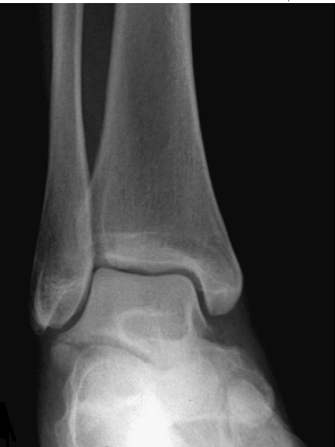

Slide 28
Question 4
4a. What is the X-ray finding?
4b. What is the mechanism of injury?
4c. How do you treat this type of injury?

Slide 29
4a. What is the X ray finding?
Isolated non-displaced fracture of lateral process of talus
(synonyms: Snowboarder's fracture, Skateboarder's fracture)

Slide 30
4b. What is the mechanism of injury?
Axial loading with the ankle in dorsiflexion and eversion.

Slide 31
4c. How do you treat this type of injury?
Non-displaced or minimally displaced (<2mm) →immobilization in a back slab/cast and with non-weight bearing for 6 weeks.
Displaced fracture for more than 2mm →orthopedic consultation for ORIF

Slide 32
Question 5
A 20 year-old man attended AED after suffering a squash ball injury to his left eye. His vision is 20/20 bilaterally. He has no tenderness over his facial bones. He has normal and painless extra-ocular movements. He denies any diplopia.

Slide 33
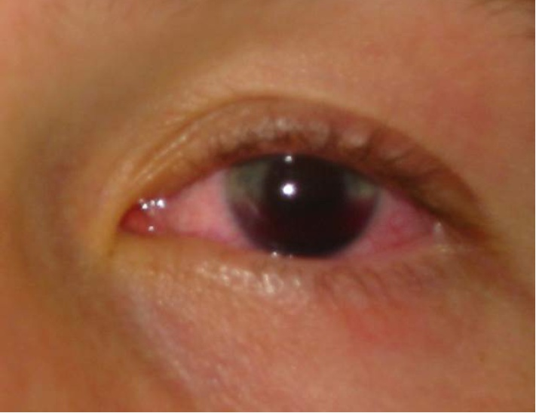

Slide 34
Question 5
5a. What is the diagnosis ?
5b. Name three causes of this condition
5c. Describe the grading system of this condition
5d. What treatments are recommended for this patient?
5e. Name 3 potential complications

Slide 35
5a. What is the diagnosis ?
Traumatic hyphaema

Slide 36
5b Name 3 causes of this condition
Trauma to the globe (blunt or penetrating)
Intraocular surgery
Spontaneous hemorrhage

Slide 37
5c Describe the grading system of this condition
Grade 1 Blood collection occupies less than 1/3 of the anterior chamber
Grade 2 Blood collection occupies 1/3 to 1/2 of the anterior chamber
Grade 3 Blood collection occupies 1/2 to less than whole of the anterior chamber
Grade 4 Total occupation of anterior chamber, often called blackball

Slide 38
5c. What treatments are recommended for this patient?
Urgent ophthalmological consultation & close follow-up
Pain control (avoid NSAIDS)
Eye shield to prevent further injury
Elevate patient’s head
Control intraocular pressure
Cycloplegics (eg. Atropine)
Discontinue anti-platelet & anticoagulant medications

Slide 39
5d. Name three potential complications.
Rebleeding
Secondary Glaucoma
Corneal staining

Slide 40
Question 6
An five-year-old boy is brought by his parents to the AED, complaining of severe abdominal cramps, recurrent vomiting, joint pain and lower limb rash for 1 day. Parents recall that the patient had a febrile illness with dry cough and running nose a week ago
Temp 38.7C, heart rate 128/min, RR 24/min

Slide 41
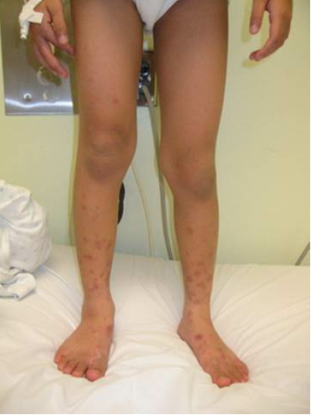
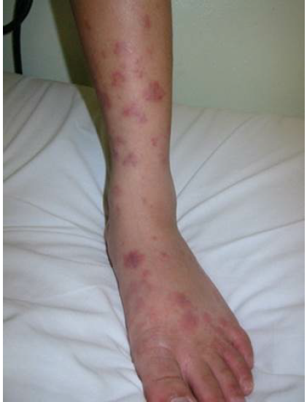

Slide 42
Question 6
6a. What is your diagnosis ? Name 3 other important diagnoses that need to rule out.
6b. What is the primary cause of this condition?
6c. Name 3 investigations
6d. What is the treatment?
6e. Name 4 complications

Slide 43
6a. What is your diagnosis? Name 3 other important diagnoses that need to rule out
Henoch Schonlein Purpura
Other important diagnosis need to rule out
  Meningococcemia
  Idiopathic thrombocytopenic purpura
  Child Abuse
  Leukemia

Slide 44
6b. What is the primary cause of this condition ?
Autoimmune vasculitis

Slide 45
6c. Name 3 investigations
Urinalysis
Blood tests: CBC, clotting, R/LFT
USG : to exclude intussusception

Slide 46
6d. What is the treatment ?
Supportive
Pain control
Steroids (esp renal involvement, severe and intractable abdominal pain)

Slide 47
6e. Name 4 complications
GI: Intussusception, Bowel perforation, Pancreatitis
Renal : Nephrotic syndrome, renal failure
Recurrent episodes of HSP
Hypertension

Slide 48
END
Thank You

